Slide 1
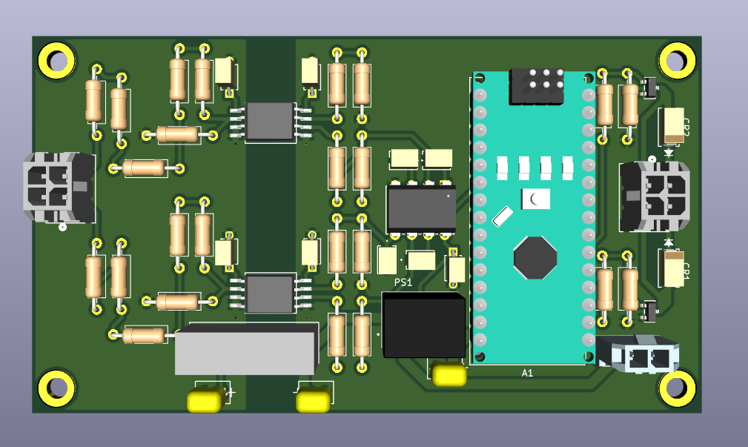
Relay
SHD IN
VInv
VBatt
GND
HV GND
AIR
V+
(Battery or 12V)
GND

